Slide 1
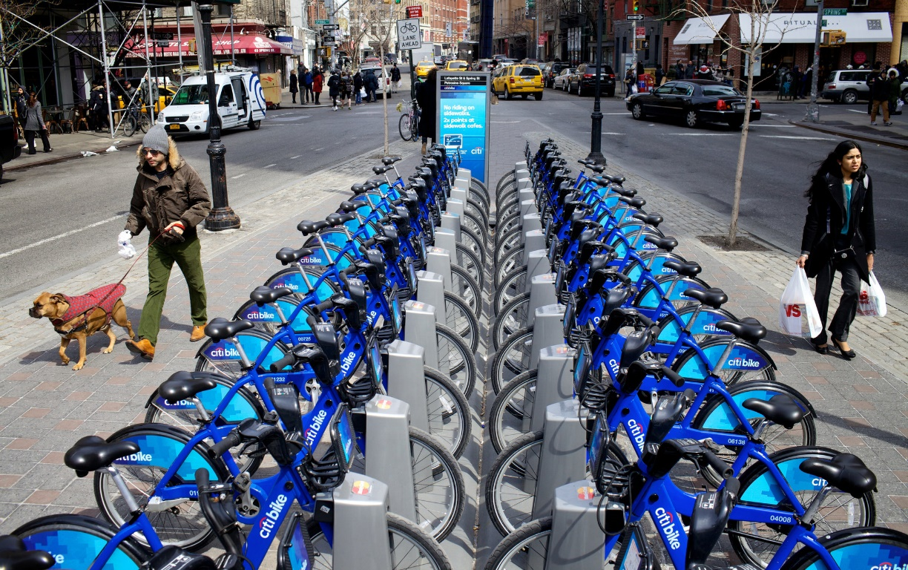


Analysis of 2013 Citibike
Trip Data
By: Shanice Green

Slide 2
Goals
Analyze the relationship between total number of trips versus average trip duration for males vs females and customers vs subscribers.
Analyze the most popular Citibike stations
Analyze bike usage by age group

Slide 3
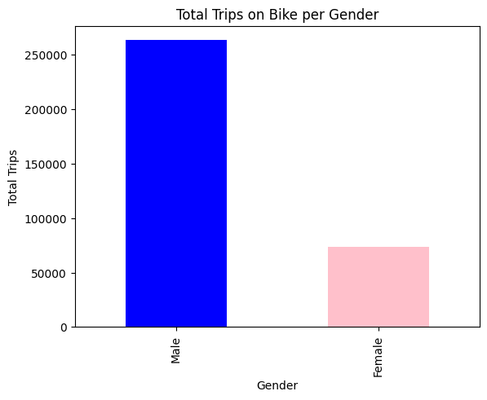
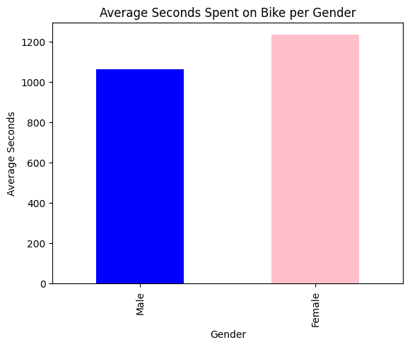
Males take more trips but on average their trips are shorter.
Females take less trips but on average their trips are longer.

Slide 4
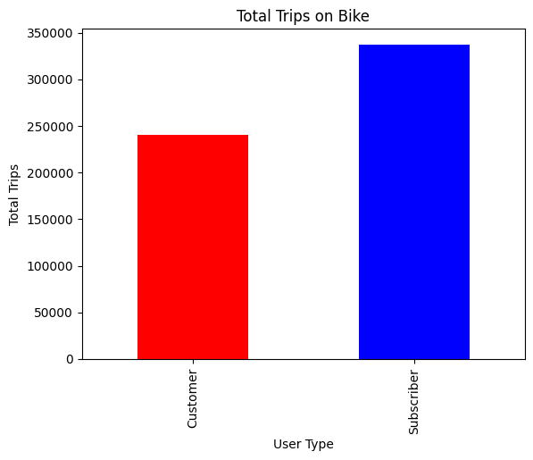
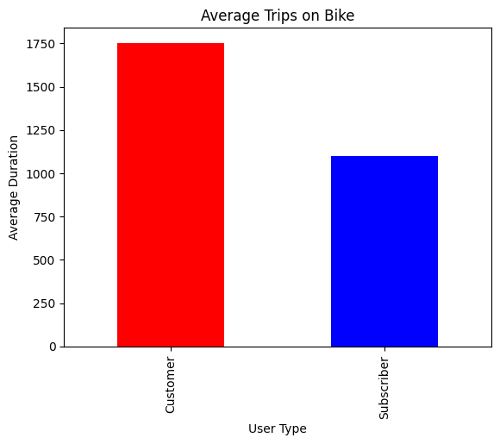
Customers take less trips but spend more time in transit
Subscribers take more trips but spend less time in transit

Slide 5
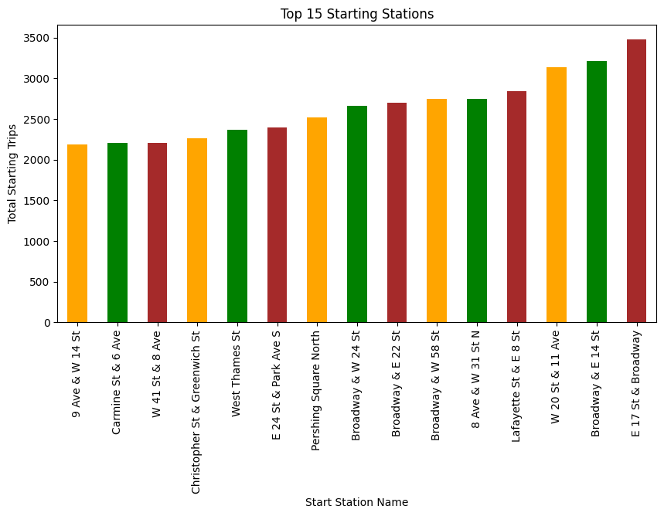
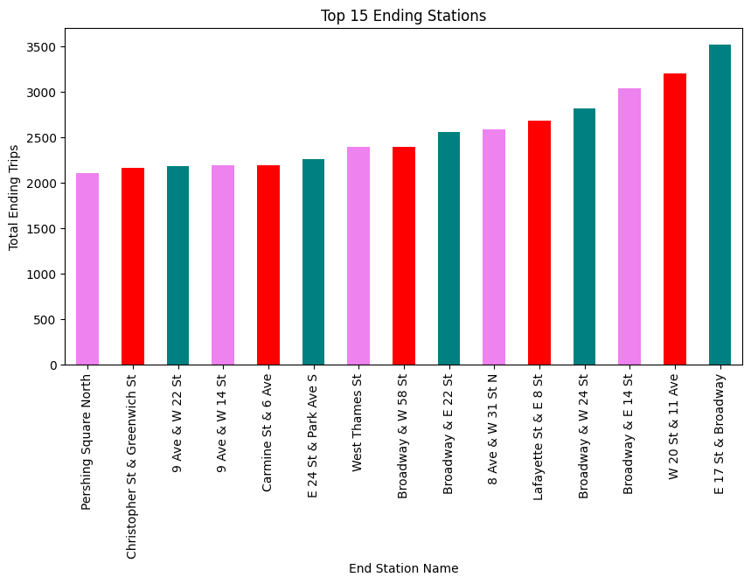
E 17 St & Broadway is the most popular station
W 20 St & 11th Avenue has an inverse relationship to Broadway and E 14th St

Slide 6
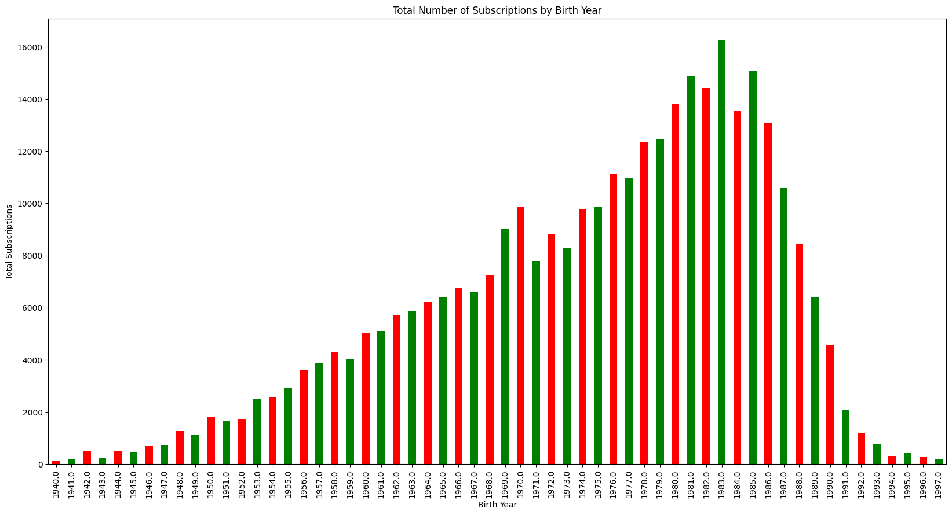
There is a popular age range from 27-33 (birth year 1980-1986)
There is an anomaly with the trend of users in the age group 42-43 (birth year 1969-1970).

Slide 7
Conclusions
Based on these results we should target
Female riders
Non-subscribed users
Ages 27-43
Focus our advertisements at these stations:
E 17 St & Broadway
W 20 St & 11th Avenue
Broadway and E 14th St

